Slide 1

Research Topics: Smart Agricultural Monitoring: Leveraging Machine Learning for Precision Disease Detection and Crop Health Optimization Paper Id: WR-CSIT-GOA-050225-10635
International Conference on The Innovation Crossroads
Authors: | Dr. Prasad Pujar
Irfan Hussain Lone | Rohan O Chokarde
Shubham Godse | Abishek Shelke
Karnatak Law Society’s
GOGTE INSTITUTE OF TECHNOLOGY
Deportment of Computer Science and Engineering

Slide 2
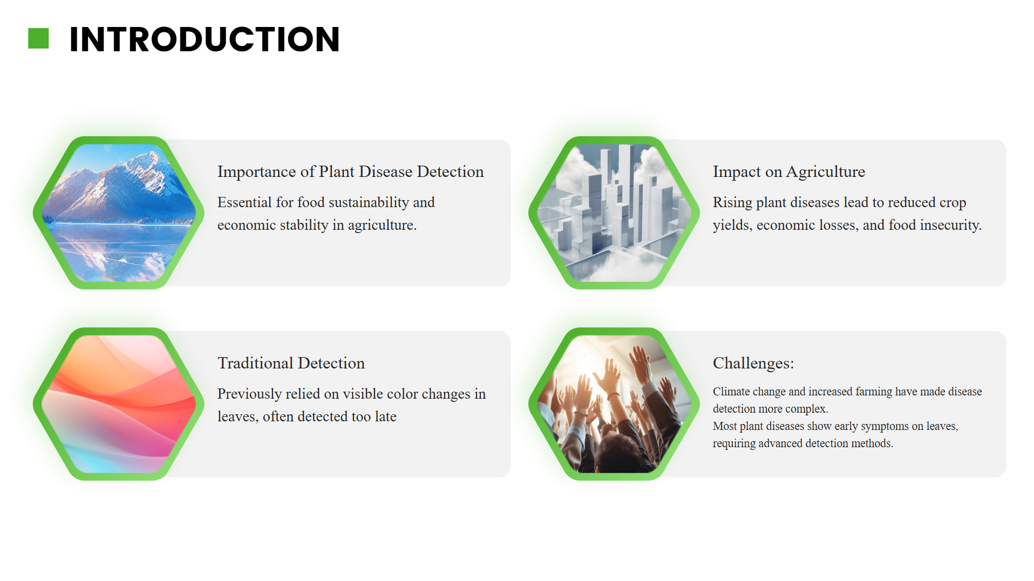

Slide 3


Slide 4
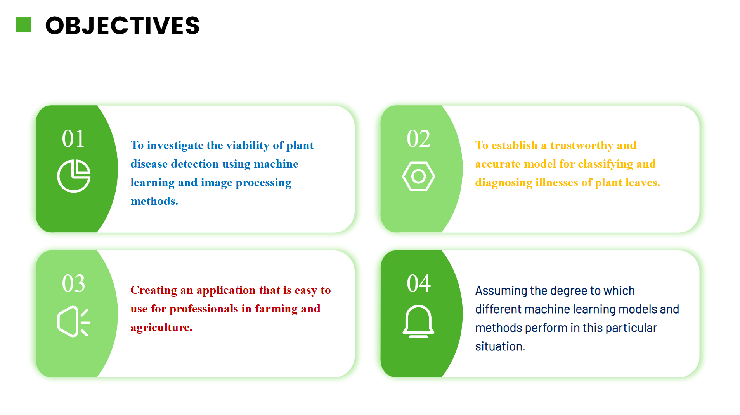

Slide 5
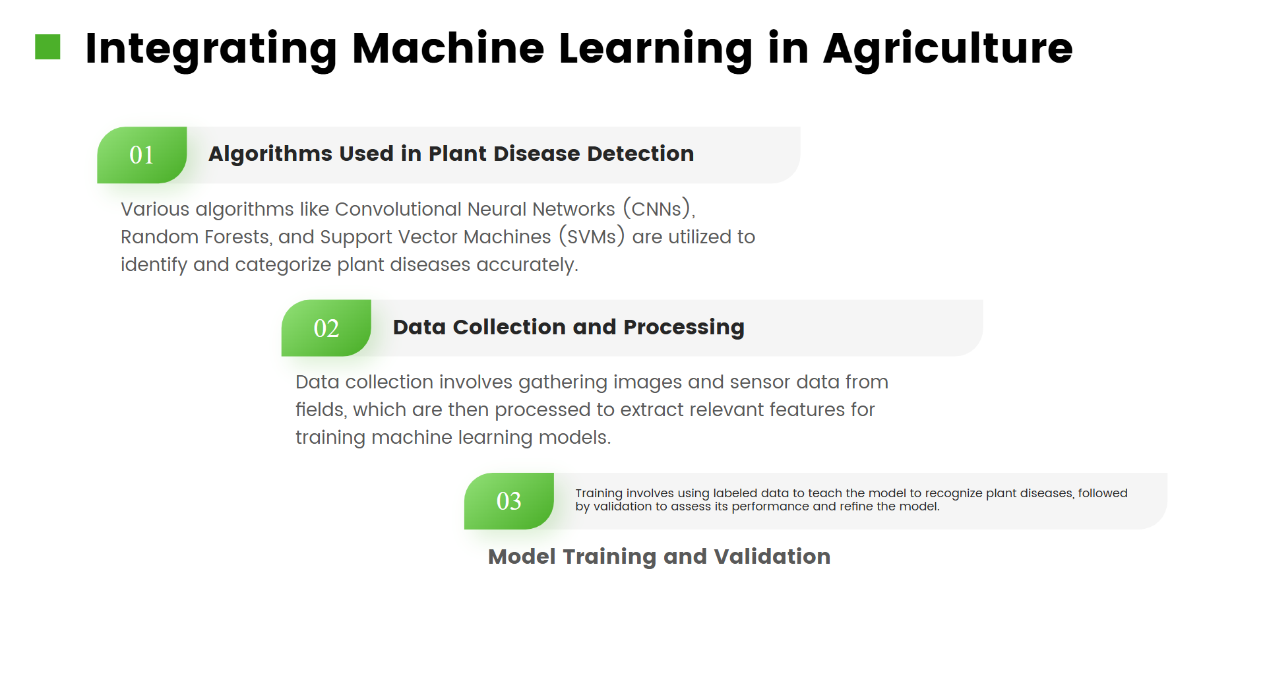

Slide 6
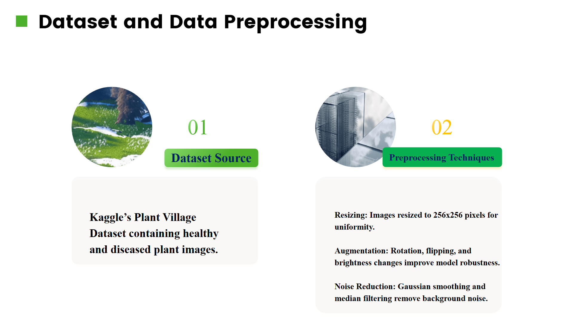

Slide 7
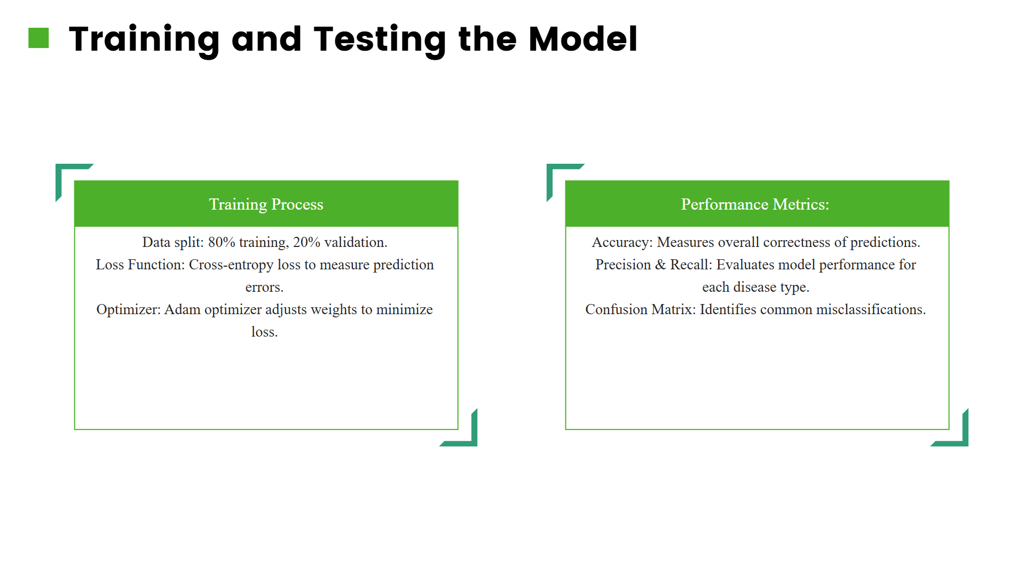

Slide 8
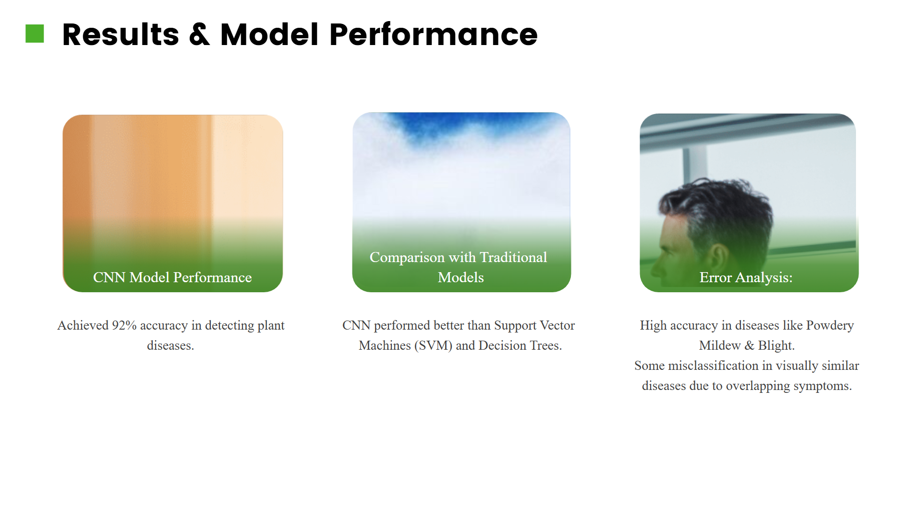

Slide 9
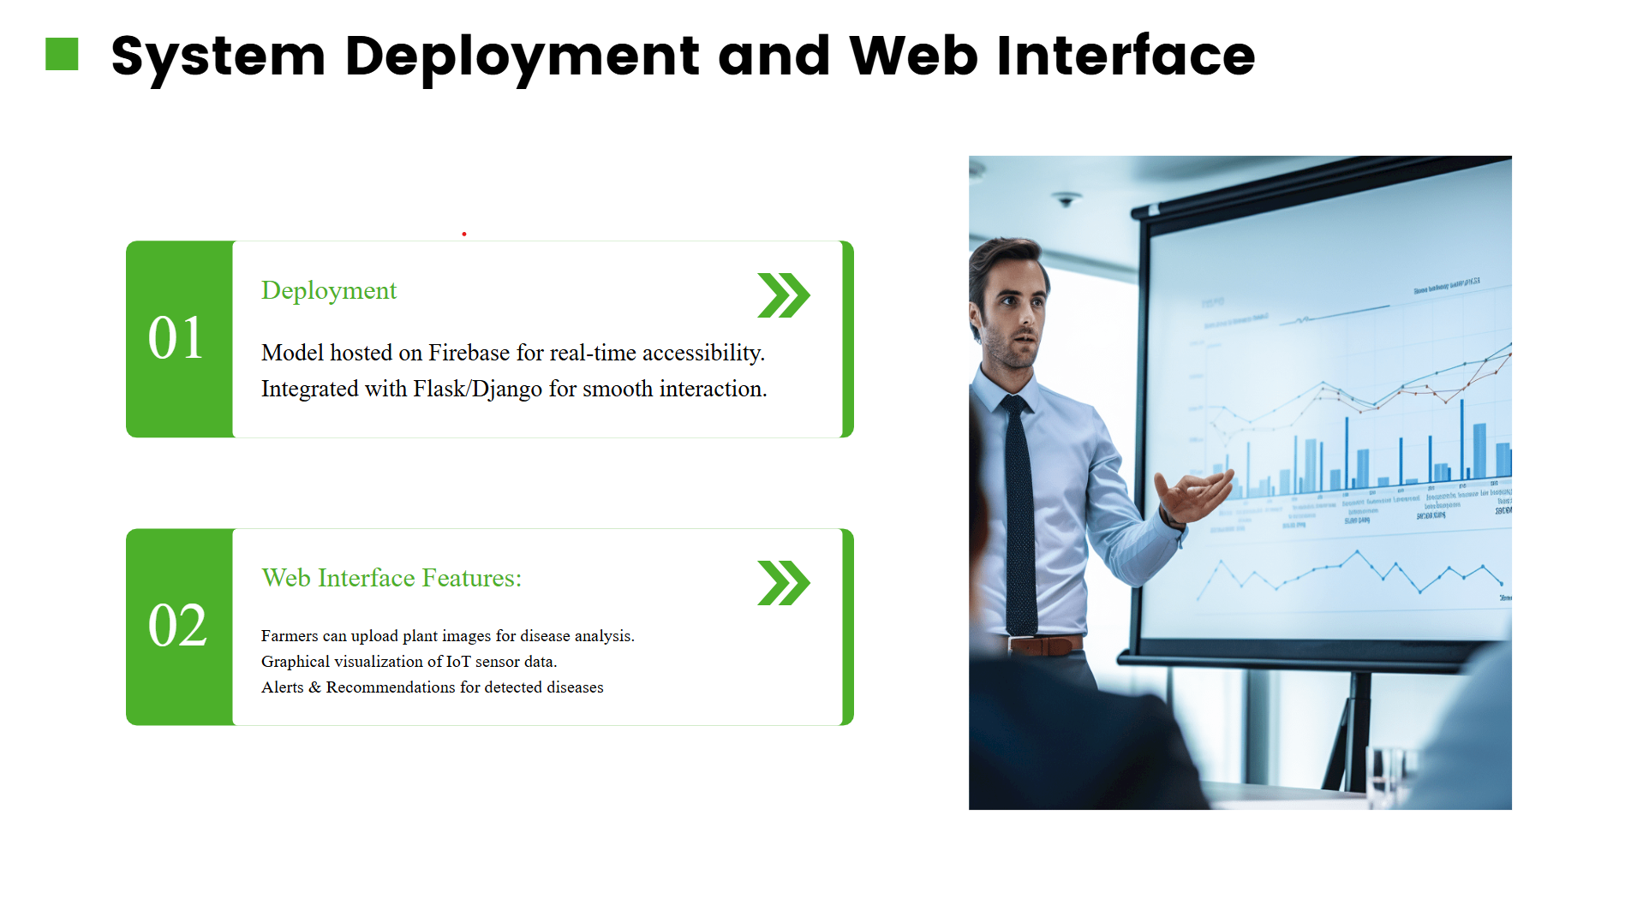
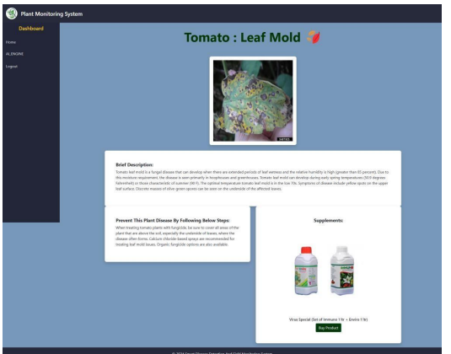
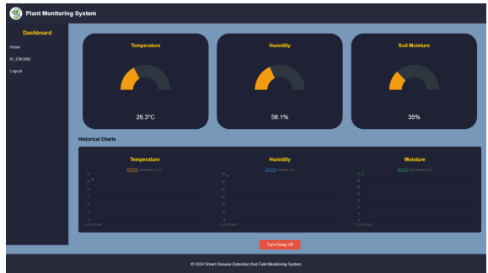

Slide 10
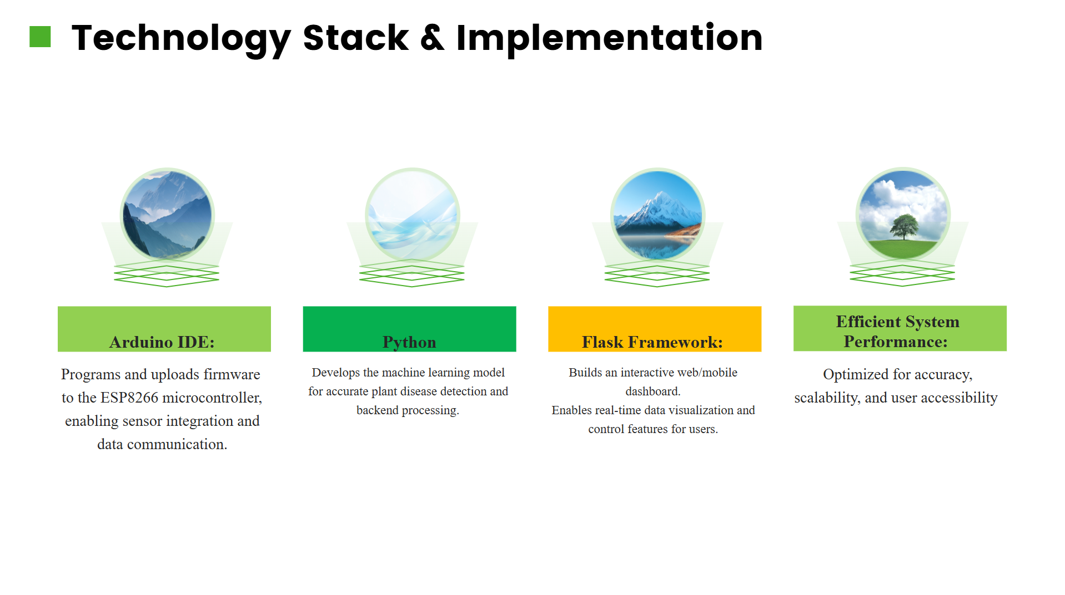

Slide 11
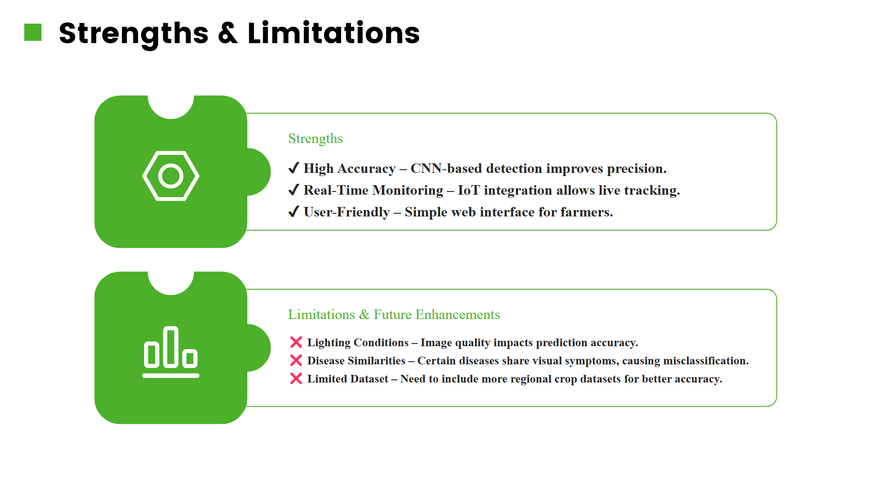

Slide 12
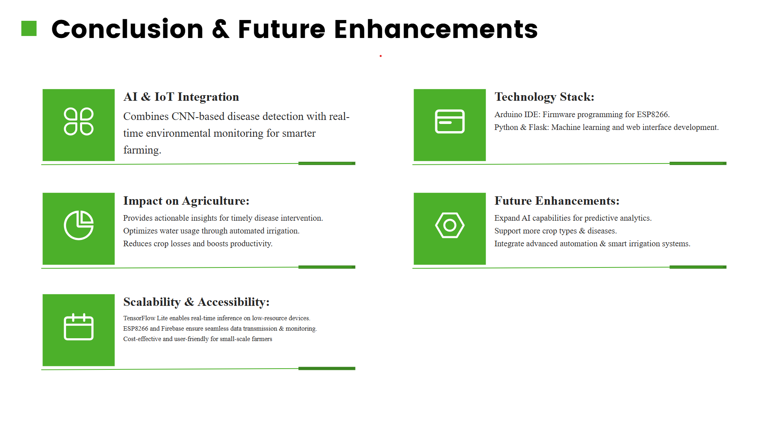

Slide 13


